Slide 1

Senior Design Project I
Week 1: Brainstorming Ideas
Presenter: Josheb P. Dayrit

Slide 2

“Turn Your Own PC into a Personal Karaoke Machine”
Why?
Because karaoke is a popular form of entertainment.
Pros?
Inexpensive. Convenient. Customizable. Most karaoke machines are heavy, both on the body and your pockets.

Slide 3
Design Requirements
1
A universal, one-size-fits-all method of separating the instrumentals and vocals of an audio file (.wav, .mp3, .mp4).
2
A scoring system that gauges pitch accuracy by comparing the karaoke singer to original singer.

Slide 4
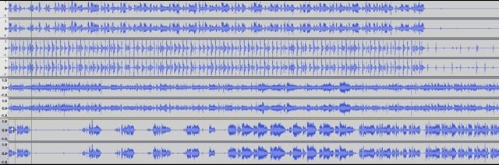
Audio Decomposition Example
Video | Isolating the Instrumental and the Vocals of a Song Using a Convolutional Neutral Network

Slide 5
Possible Implementation of Scoring System
Through LibROSA, a Python Library for Audio Processing and Analysis
LibROSA functions can take audio files as an input and generate spectrograms (with time as x, and frequency as y) as outputs. Frequency will be the observed variable here.
Compare frequencies? Why? Because certain frequencies correspond to specific notes. We can distinguish notes in a song based on their frequencies.
By comparing the spectrogram of the original singer with the spectrogram of the karaoke singer, we can see if the recorded frequencies are similar. Based on how similar they are, a score can be generated.

Slide 6
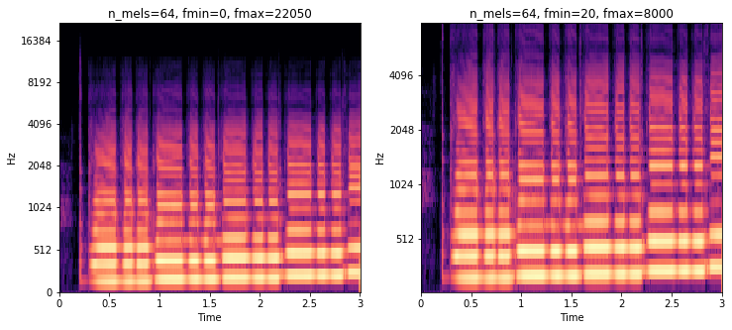
LibROSA Melspectograms

Slide 7
“A Neutral Network ASL (American Sign Language) Translator”
Why?
Communication tool with deaf persons, specifically through mediums such as Skype or FaceTime.
Pros?
Do not have to hire a translator. Do not have to learn ASL. Easy-to-use since the neural network does all the work.

Slide 8
Design Requirements
1
A neutral network that is trained to recognize ASL gestures and motions, converting them to text in real-time.
2
Method of conversion from speech to ASL, to allow two-way interactions. The same neutral network can be trained for this purpose, as well.

Slide 9
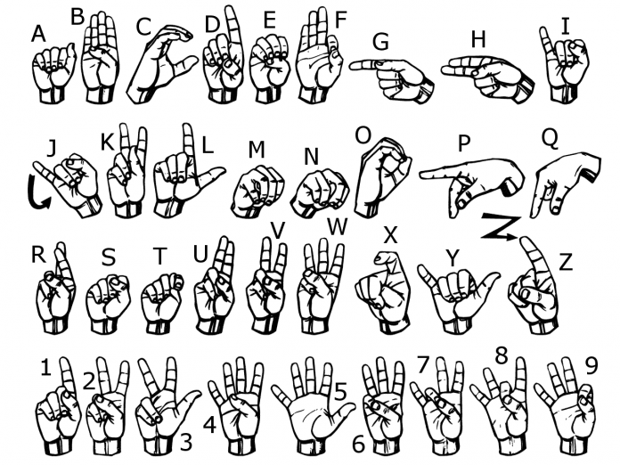
Similar Project (1)
Step 1:
An ASL dataset was used as training material for a neutral network.
Dataset (which is a series of images depicting the English alphabet) is on the right.

Slide 10
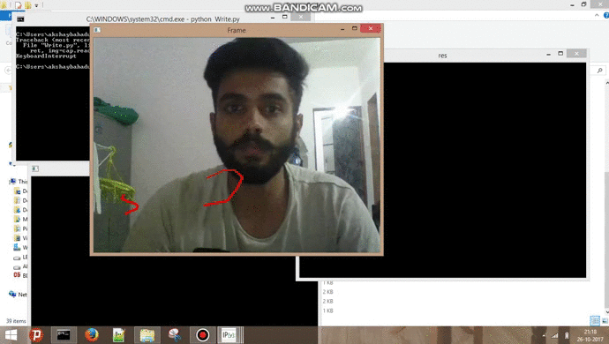
Similar Project (2)
Step 2:
OpenCV (Open Source Computer Vision) was used to track gestures and motions.
The neural network tried to figure out which alphabet was represented by the tracked gestures.

